Slide 1

#OneOfTheOnes Photo Series

Slide 2

Objectives
Showcase the diverse campus community and members therein that constitute “The Ones”
Raise awareness for different areas of SU
Provide content for #OneOfTheOnes social media campaign

Slide 3
Social Media Platforms
Facebook
Instagram
Twitter
Tumblr
Pinterest

Slide 4
Interview Prompts
What brought you to Seattle University?
What led you to study ______?
What is the best part about your major?
What is one favorite member from your time at SU?
Is there anything you wish you knew before coming to SU?
What is one goal you are working on right now?
Where do you hope to be in 5 years?
What kind of impact do you want to have in the world?
What kind of leader do you want to be?
What do you think makes you #OneOfTheOnes?

Slide 5
SU Community as Brand Ambassadors
Seattle U makes social media post
Social Media Team notifies person profiled
Person profiles shares to their network
SU brand social reach increases

Slide 6
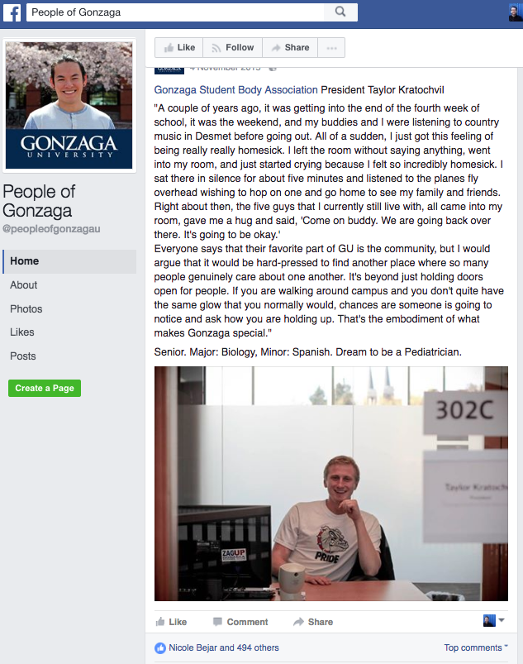
Inspiration: People of Gonzaga

Slide 7
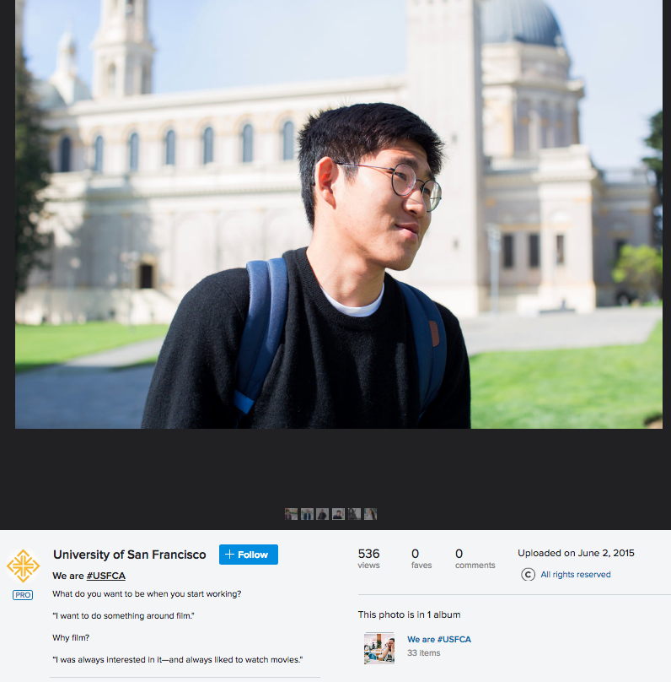
Inspiration: We are #USFCA

Slide 8
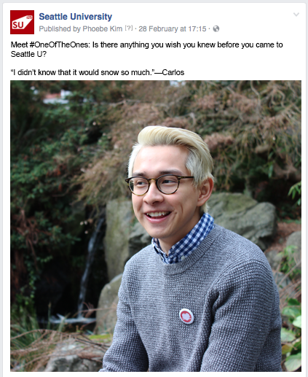
Facebook Sample

Slide 9
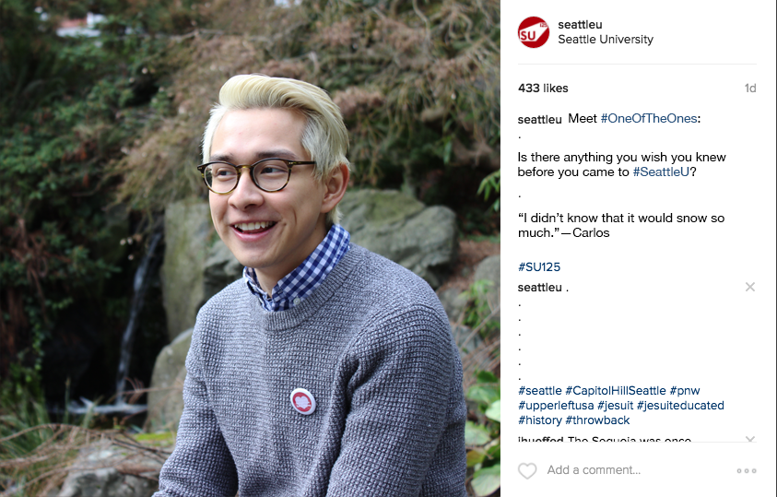

Slide 10
